Slide 1
IST772 (IST772) Probabilities Over the Long Run (Week 3)
Copyright 2019, Jeffrey Stanton
Pre-class activity: Is this a distribution of raw data or a sampling distribution? How do you know? Send your answer in a chat message to me (not to the whole group).

Slide 2
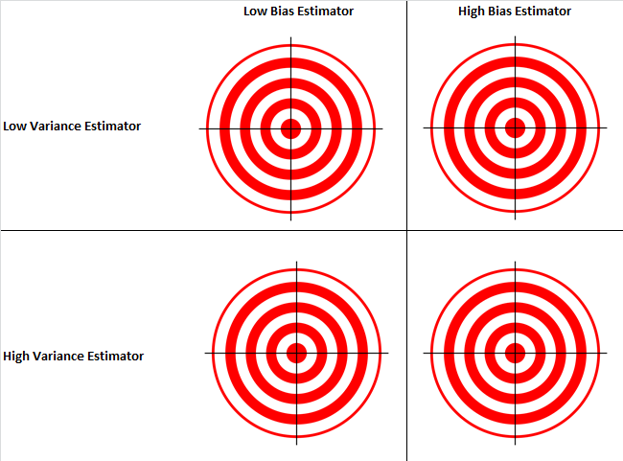
The Frequentist Philosophy
There is an unknown population parameter that has a fixed value
We want to estimate that parameter from sample data
The goal is to create estimators (statistical procedures) that will converge on the fixed, but unknown parameter over many replications
Good estimators have the smallest possible bias (distance between the estimate and the fixed unknown value) and the smallest possible variance (variation among replications)
(Simulations provide a method of understanding the properties of such estimators)

Slide 3
Our Goal: A Special Standard Deviation
This plot shows the standard deviation of sampling distributions that were created using different sample sizes (ranging from 4 to 100).
The original population had sd = 10.
The standard deviation of a sampling distribution has a special name: the Standard Error of the Mean.
What is the relationship between population SD, sample size, and standard error of the mean?

Slide 4
Breakout 1 – Marking a Population Distribution
Create a large population of test scores with a random number generator
Display a histogram with the result
Mark various points on the X-axis with abline( )

Slide 5
hist(testPop) abline(v=quantile(testPop, probs=0.025),col="green") # Lower tail abline(v=quantile(testPop, probs=0.975),col="green") # Upper tail

Slide 6
Original Population Versus Sampling Dist

Slide 7
Breakout 2 – Sampling Dist Case Studies
Start by re-generating the plot on the previous slide
Then create additional plots of sampling distributions to reason about the case studies
Each case study has a slightly different scenario for sample size: You will mark the boundaries of the central region and the position of the sample mean provided in the scenario
Then reason about what the position of the sampling mean implies
If you are fast, there are two bonus cases

Slide 8
Case Studies A through D
A: n=100, Xbar=101 B: n=49, Xbar=104 C: n=500, Xbar=101 D: mu=50, n=64, Xbar=48

Slide 9
Dispersion of the Sampling Distribution
The Central Limit Theorem states that over the long run the mean of the sampling distribution will match the mean of the underlying population.
The dispersion of the sampling distribution depends upon the dispersion of the underlying population.
But there is also another influence that affects the dispersion of the sampling distribution. Consider the code on the following slide.

Slide 10
A Special Standard Deviation
sdVector <- NULL # Start a list with nothing
sampSizes <- (2:10)^2 # A list of 9 sample sizes ranging from 4 to 100
for (i in sampSizes)
{
# Do a sampling distribution for each sample size
samplingDistribution <- replicate(1000, mean(sampleTestScores(i)))
# Add the standard deviation of that sampling distribution to the list
sdVector <- c(sdVector, sd(samplingDistribution))
}

Slide 11
A Special Standard Deviation
This plot shows the standard deviation of sampling distributions that were created using different sample sizes (ranging from 4 to 100).
Remember that the original testPop population had sd = 10.
The standard deviation of a sampling distribution has a special name: the Standard Error of the Mean.
What is the relationship between population SD, sample size, and standard error of the mean?

Slide 12
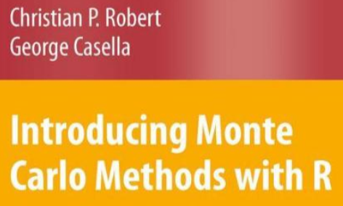
Paper of the Week – Excerpt (Chapter 2) from Robert & Casella, 2010
Generating random distributions to test our statistical reasoning requires accurate generation of “pseudo-random” numbers
Today, we sampled hundreds of thousands of random samples that were each independent of one another
Our capability to conduct Bayesian estimation depends upon being able to sample from a distribution where each sample is dependent solely on the previous sample
Robert & Casella do a deep dive into sampling and Monte Carlo methods in their book (email me if you are interested in the whole book)

Slide 13
Homework
Make sure to include all of your R code in your homework submission. All of these are OK:
Paste the code into various spots in your word document
Include the code as a separately uploaded file
Use Markdown and submit the Rmd file (or echo all of the chunks)
Make sure you are thoroughly commenting your code for future use!
The homework for week three is exercises 2 through 7 on pages 50 and 51.

Slide 14
Using the Mean and the Std Err. . .
Note that only half of the central region is shaded.
library(ggplot2)
# The Standard Normal Curve
fx <- function(x) {1/sqrt(2*pi) * exp(-x^2/2)}
# Create data to plot the curve
df1 = data.frame(x = seq(from=-4,to=4, by=0.01))
df1$f = fx(df1$x)
# Plots the curve with the area filled in
df1a <- df1[df1$x>0 & df1$x<2,]
ggplot(df1, aes(x,f)) +
geom_line(color = 'magenta', size = 0.8) +
ylab('f(x)') + xlab('x') +
geom_area(data=df1a, aes(x,f), fill='blue')

Slide 15
Calculate Area Under the Normal Curve
# Plot the normal CDF with pnorm
df4 = data.frame(x=seq(from=0,to=4, by=0.01))
# Mean of 0, SD of 1
df4$f = pnorm(df4$x, 0 , 1, lower.tail = TRUE)
ggplot(df4, aes(x,f)) +
geom_line(color = 'magenta', size = 0.8) +
ylab('Normal CDF') +
xlab('x') +
geom_hline(yintercept=0.975)

